Slide 1
OGZEB Hybrid Thermal/Electrical Energy Storage System
Midterm 1 Presentation
Team Members: Corey Allen, Anthony Cappetto, Lucas Dos Santos, Kristian Hogue, Nicholas Kraft, Tristian Jones, Artur Nascimento
Sponsors/Advisors: Dr. Li, Dr. Ordonez, Dr. Zheng
Instructors: Dr. Amin, Dr. Shih
October 24th, 2013
Lucas Dos Santos

Slide 2
Meet the Design Team
Mechanical Engineers
Tristan Jones- Project Lead
Nicholas Kraft- Treasurer
Artur Nascimento (Brazilian Foreign Exchange)
Lucas Dos Santos (Brazilian Foreign Exchange)
Electrical Engineers
Corey Allen- E. E. Lead
Anthony Cappetto- Bookkeeper
Kristian Hogue- Webmaster
Lucas Dos Santos

Slide 3
Outline
OGZEB Background
Project Scope
Project Objectives
Thermal Energy Storage System Concepts
Concept Evaluations
Concept Selection
Challenges/Risks
Battery Design Outline
Battery Simulation
Task Breakdown/Gantt Chart
Summary
Questions
Lucas Dos Santos

Slide 4
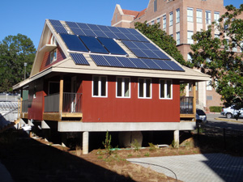
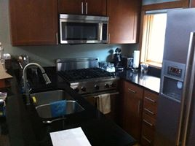
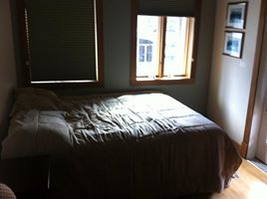
OGZEB Background
Off-Grid Zero Emission Building
FSU campus between Love and Carothers Building
U.S. Green Building Council Platinum LEED Certification
Powered entirely by PV panels, geothermal, or solar thermal energy
Sponsored by FSU’s Environmental and Sustainability Center
Mission is to showcase how alternative energy solutions can be used to lower humanity’s environmental impact
Lucas Dos Santos

Slide 5
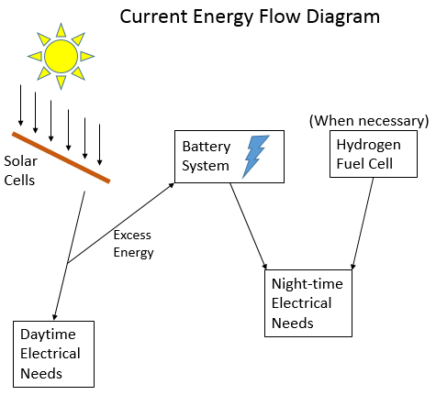
Project Scope
Current solar cell output exceeds house usage
Current battery storage system is out of date and cannot store enough energy to power the house through the night
Excess energy beyond battery storage is run directly to ground, effectively wasting energy
When necessary hydrogen is run through a fuel cell to power the house
Purchasing new batteries is extremely expensive and unsustainable
Lucas Dos Santos

Slide 6
Project Expectations
1. Battery design:
a. Gathering Data
b. Battery selection
2. Grid-connected electrical system design ( PV, battery, grid)
a. House power system configuration and control
b. Tallahassee utility, smart meter, smart device
3. Efficiency:
a. Stand-alone
b. Grid-connected
4. Battery thermal management
5. PV thermal energy
Anthony Cappetto

Slide 7
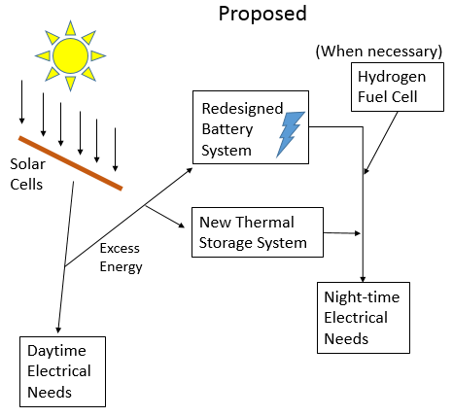
Objectives
The goal of the group is to create a hybrid thermal/electrical storage system capable of storing enough energy to power the house throughout the night
The thermal storage system will work in tandem with a smaller, more optimized battery array
The new system will maintain the OGZEB’s commitment to environmental sustainability
The system will be as inherently safe as possible
System will be developed as cheaply as possible
Lucas Dos Santos

Slide 8
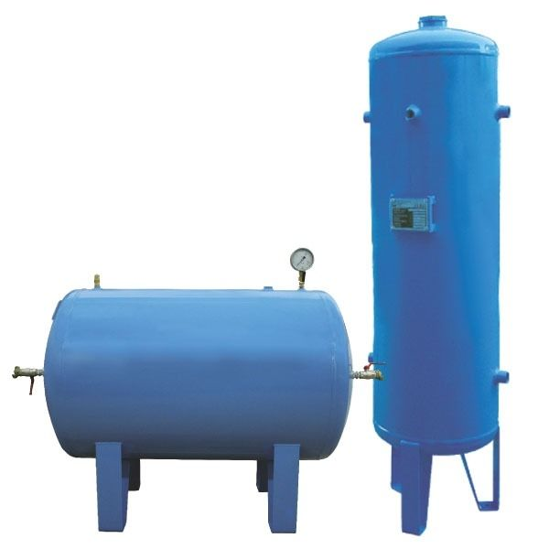
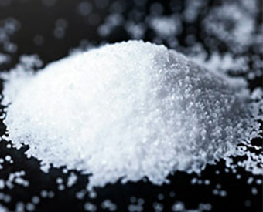
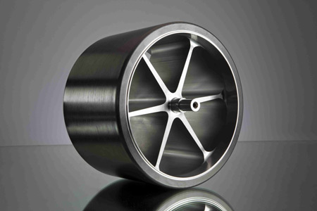
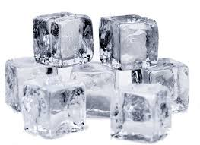
Potential Thermal/Mechanical Design Concepts
a) Compressed Air Storage
b) Molten Salt Thermal Storage
c) Hydroelectric Energy Storage
d) Flywheel
e) Ice Storage
Nicholas Kraft

Slide 9
Molten Salt Heat Exchanger
Advantages
Conceptually simple
Eliminates combustion in the case of a boiler therefore virtually eliminating issues involving emissions.
Disadvantages
Multiple energy conversions lead to possible inefficiencies
Molten salt or other heat transfer fluid is expensive
Danger of storing high temperature material
Multiple storage tanks consume a substantial amount of space.
Nicholas Kraft

Slide 10
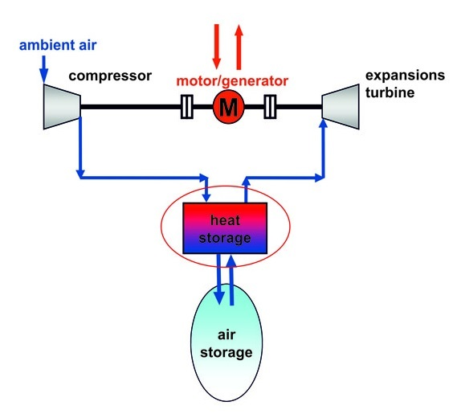
Compressed Air Storage
Advantages
Conceptually simple to understand
Disadvantages
Expensive Components
Multiple energy conversions could lead to lower efficiency.
Above ground tank size limits amount of air storage.
Complex Maintenance
Compressor leakage and heat losses in above ground air storage.
Nicholas Kraft

Slide 11
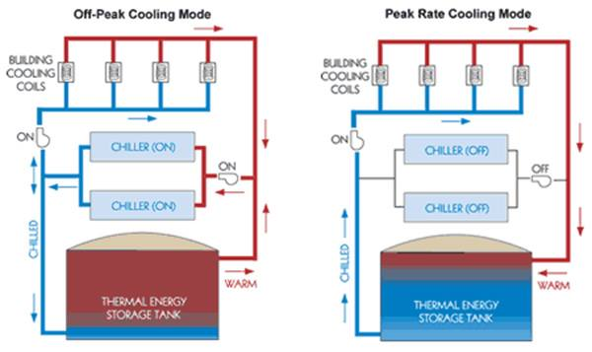
Ice Generation
Advantages
Efficient
Very little if any emissions
Cost efficient relative to other concepts
Safe operation
Could add a thermoelectric concept (not likely but still an option)
Disadvantages
Relatively complex
Requires high insulation to prevent heat transfer from the environment into storage tank.
Size constraints
Nicholas Kraft

Slide 12
Selection of Design Concept
Concept |  | Weight |  | Weight |  | Weight |  | Weight |  | Weight | Total Score (150 possible)
 | Cost | 2 | Size | 5 | Safety | 1 | Feasibility | 4 | Efficiency | 3
Compressed Air | 2 |  | 4 |  | 2 |  | 3 |  | 3 |  | 47
Molten Salt | 2 |  | 2 |  | 3 |  | 2 |  | 2 |  | 31
Hydroelectric | 3 |  | 4 |  | 7 |  | 5 |  | 5 |  | 68
Ice generation | 4 |  | 6 |  | 6 |  | 7 |  | 6 |  | 90
Flywheel | 5 |  | 6 |  | 3 |  | 7 |  | 6 |  | 89
Nicholas Kraft

Slide 13
Challenges
Challenge Accepted!!!!
Budget is not clearly defined.
Overall system efficiency must be at least average.
System must be relatively low cost.
Safety is high priority.
Low maintenance.
Maintain the standards of a Platinum LEED certification.
Nicholas Kraft

Slide 14
Gathering Data from the OGZEB
Gathering OGZEB data has proven to be difficult
Until we get that data we have been provided sample data
With this information we are able to begin our simulation
When we receive the actually data we will modify our simulations
Anthony Cappetto

Slide 15
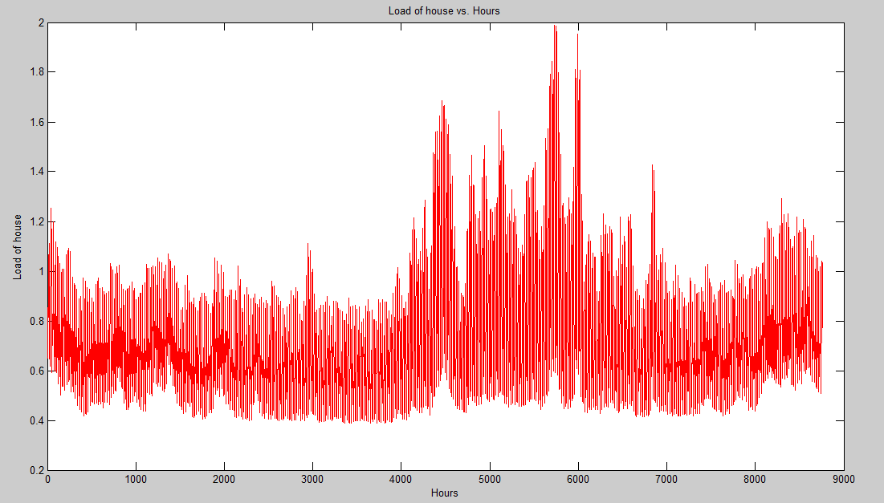
Load Consumed by the House
Anthony Cappetto

Slide 16
Load Consumed by the House
1 - 1.2 kW
Anthony Cappetto

Slide 17
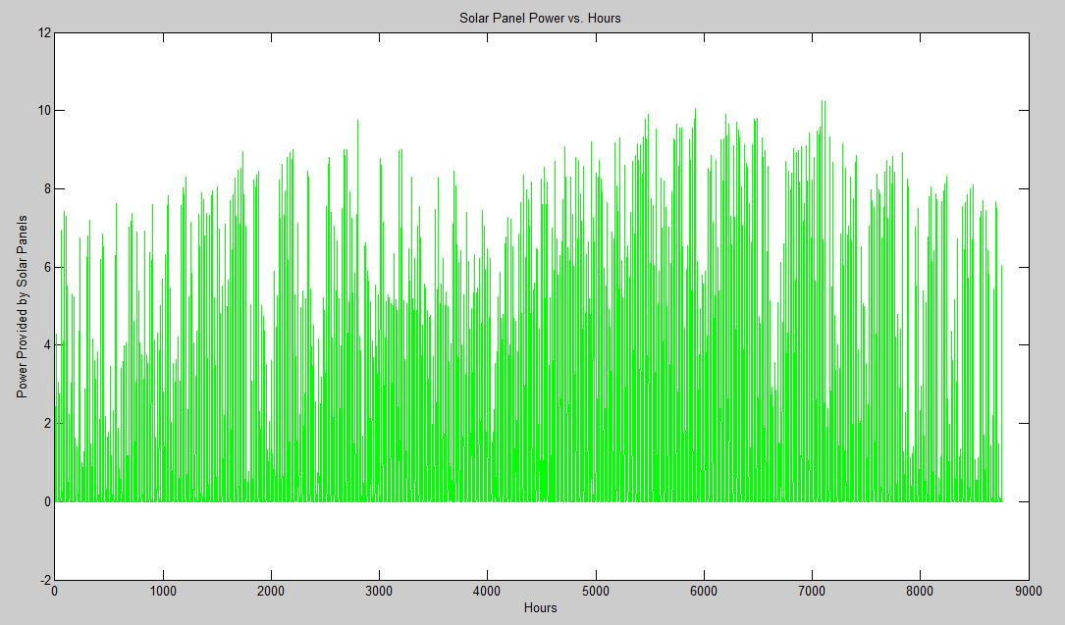
Power Provided by Solar Panels
Anthony Cappetto

Slide 18
Power Provided by Solar Panels
6.9 kW
Anthony Cappetto

Slide 19
Solar Panel Power & Power Consumed by house vs Hours

Slide 20
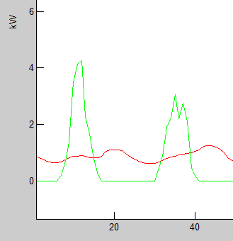
Energy Management Strategy
When the Power Output of the solar
panels exceed that of the power
consumed by the house. We switch to
solar power to run the house.
During this time we also charge the batteries
When the opposite condition is true, the batteries
must supply power to the house.
Charge
Charge
Anthony Cappetto

Slide 21
Battery Selection Options
Concept |  | Weight |  | Weight |  | Weight |  | Weight |  | Weight | Total Score (150 possible)
 | Cost | 4 | Size | 1 | Safety | 5 | Feasibility | 2 | Efficiency | 3
Lithium | 2 |  | 10 |  | 5 |  | 3 |  | 9 |  | 76
Nickel Metal Oxide | 5 |  | 7 |  | 6 |  | 7 |  | 6 |  | 89
Lead Acid | 10 |  | 5 |  | 8 |  | 8 |  | 4 |  | 113

Slide 22
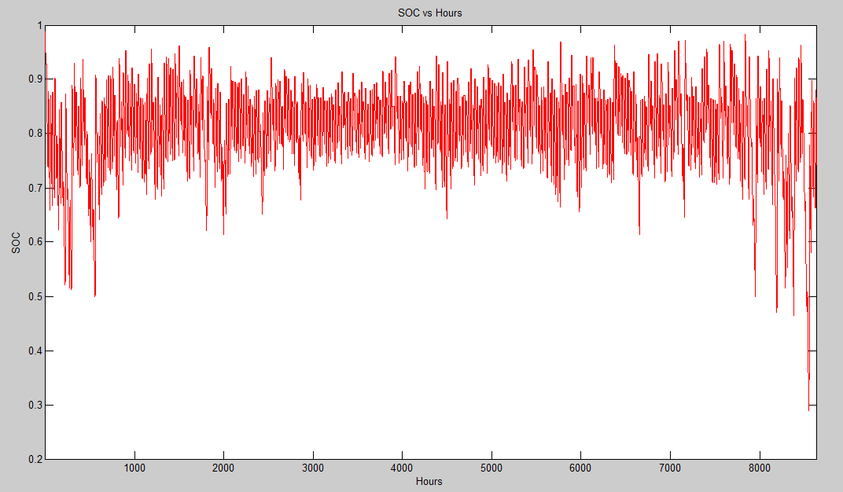
Simulation with LiFePo4 – State of Charge
20%
Notes:
Mr. Greenleaf specializes in battery modeling and simulation using Matlab.
0.2 is the minimum

Slide 23
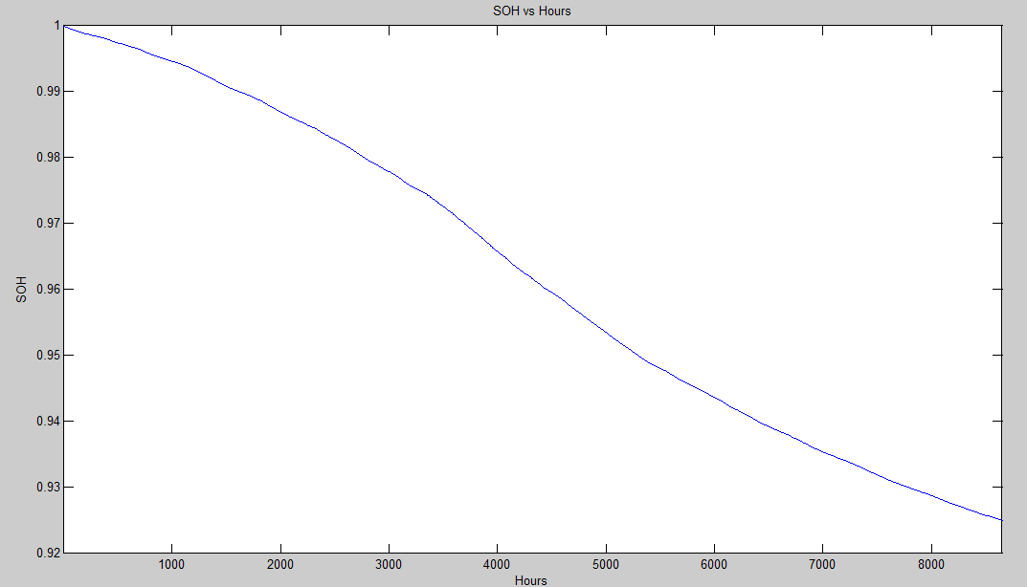
Simulation with LiFePo4 – State of Health
Notes:
Mr.
Greenleaf specializes in battery modeling and simulation using Matlab.

Slide 24
Analysis of the LiFePo4 Simulation
SOC tells us when the battery charges/discharges
Never goes below 20%
Batteries are oversized
1/SOH = 1/0.0751 ≈ 13.32 years

Slide 25
Future Goals
Compile Weather Information over the past year (Simulation purposes)
Find a way to get more accurate Annual Load Data
Incorporate Lead Acid battery model for simulation
Cost Analysis of the 3 battery options

Slide 26
Gantt Chart for Deliverables
Anthony Cappetto

Slide 27
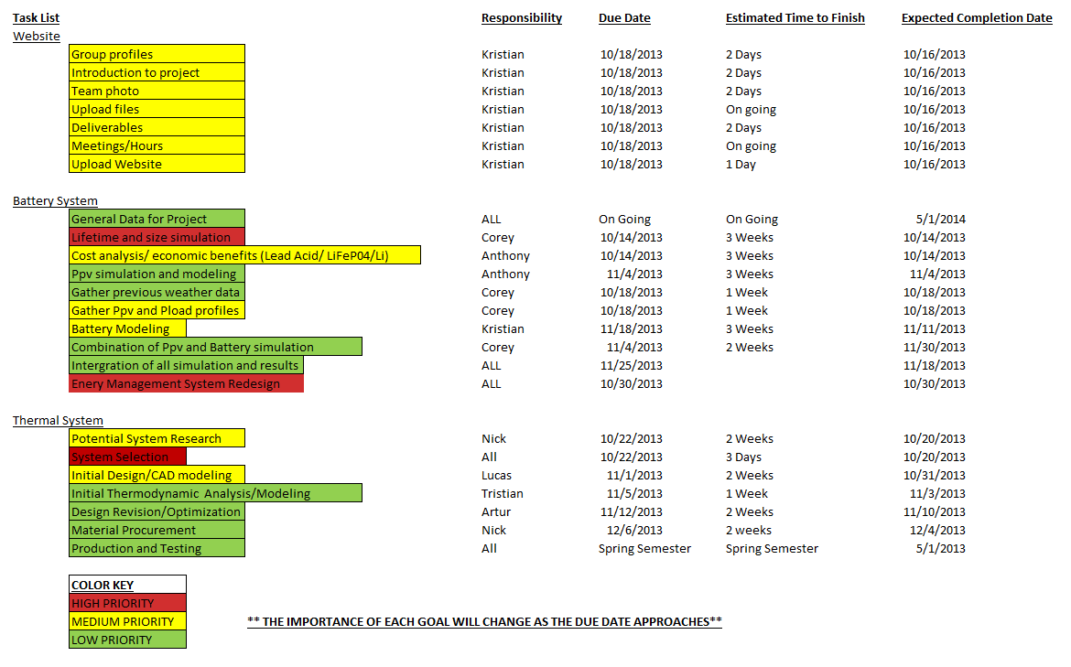
Task Schedule
Anthony Cappetto

Slide 28
Summary
The OGZEB (Off Grid Zero Emissions Building) is a Platinum LEED certified building by the U.S. Green Building Council with a mission to showcase how alternative energy solutions can be used to lower humanity’s environmental impact.
Ice Storage was chosen over Compressed Air Energy Storage and Molten Salt Energy Storage due mostly to its suitability to the needs of the house.
The battery redesign and replacement also remains a top priority due to the age and lack of energy storage potential of the current battery system. Lead Acid batteries will be used over other options due mostly to their cost efficiency.
Some important challenges the design team may have to overcome include the lack of a well defined budget, expense of materials, system integration with the house, and maintaining the standards of a Platinum LEED Certification.
Anthony Cappetto

Slide 29
Questions?

